Slide 1

Marketing Analytics

Slide 2
Part - I

Slide 3



Company Information
Founded: 2008, San Francisco, CA
Online marketplace connecting hosts and guests for short-term stays and experiences
Global Reach: 220+ countries and regions, 4M+ hosts, 150M+ users
Offerings:
Vacation rentals (rooms, homes, unique stays)
Airbnb Experiences (tours, events)
Airbnb for Work (corporate travel)
Revenue Model: Service fees from bookings (hosts and guests)
"Create a world where anyone can belong anywhere"

Slide 4
What is the Problem?
Problem Statement: Our goal is to analyze how location affects occupancy rates for Airbnb listings in Paris. While some neighborhoods experience consistently high bookings, others may struggle due to pricing, competition, or lack of tourist appeal.
Key Question to Address:
Which neighborhoods in Paris have the highest and lowest Airbnb occupancy rates?
Additional Questions that can be answered through this group project:
Are occupancy rates correlated with proximity to popular tourist attractions?
Are some neighborhoods oversaturated with listings, leading to lower occupancy due to competition?
How do different room types compare in terms of popularity and preference?

Slide 5

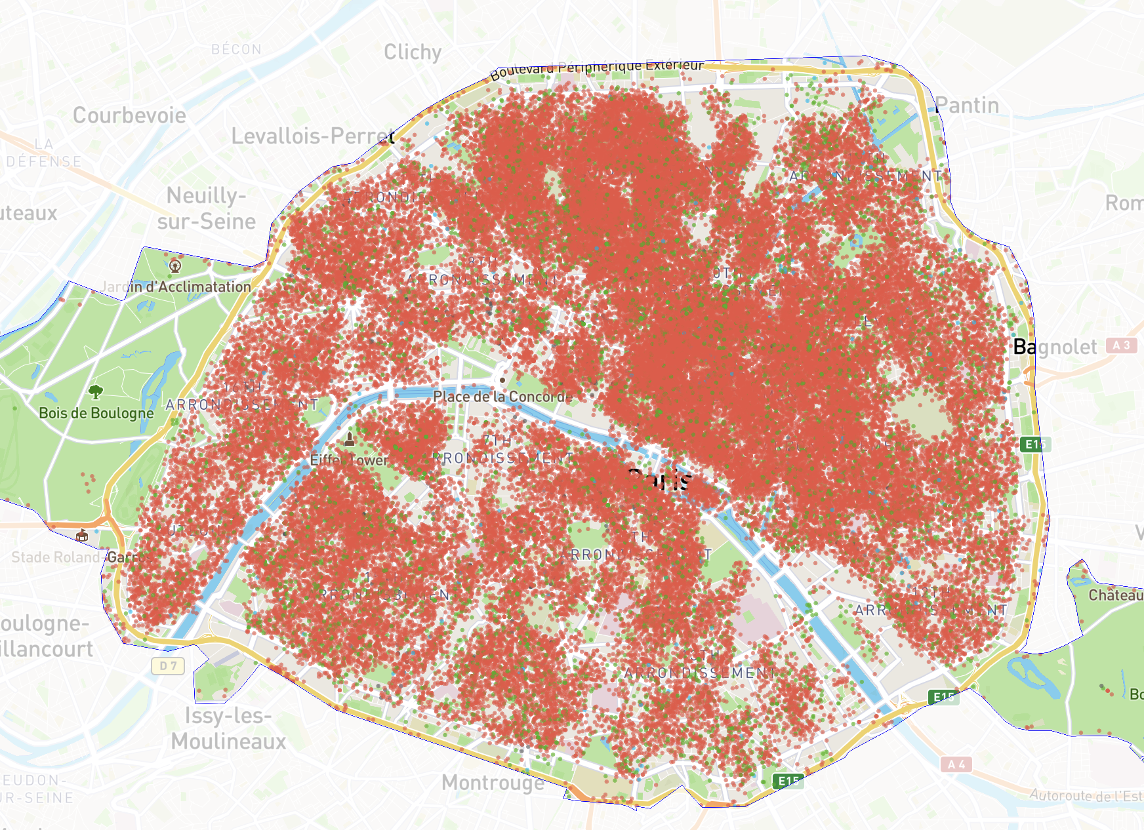
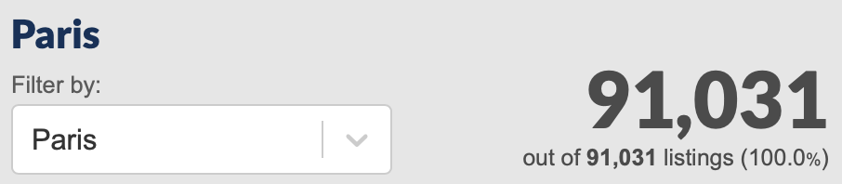
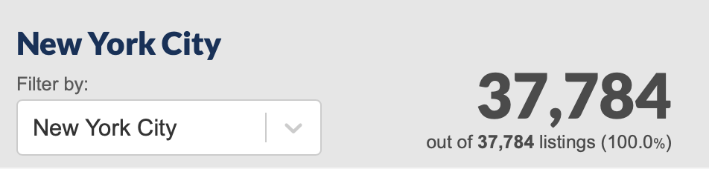
Location
Paris, France
91,031 listings (based on insideairbnb)
Known as the "City of Light" and the “City of Love”
One of the most visited cities in the world, attracting over 30 million tourists annually
Notes:
Guide for the Arrondissements: https://www.parisinsidersguide.com/paris-arrondissements.html

Slide 6
Part - II

Slide 7
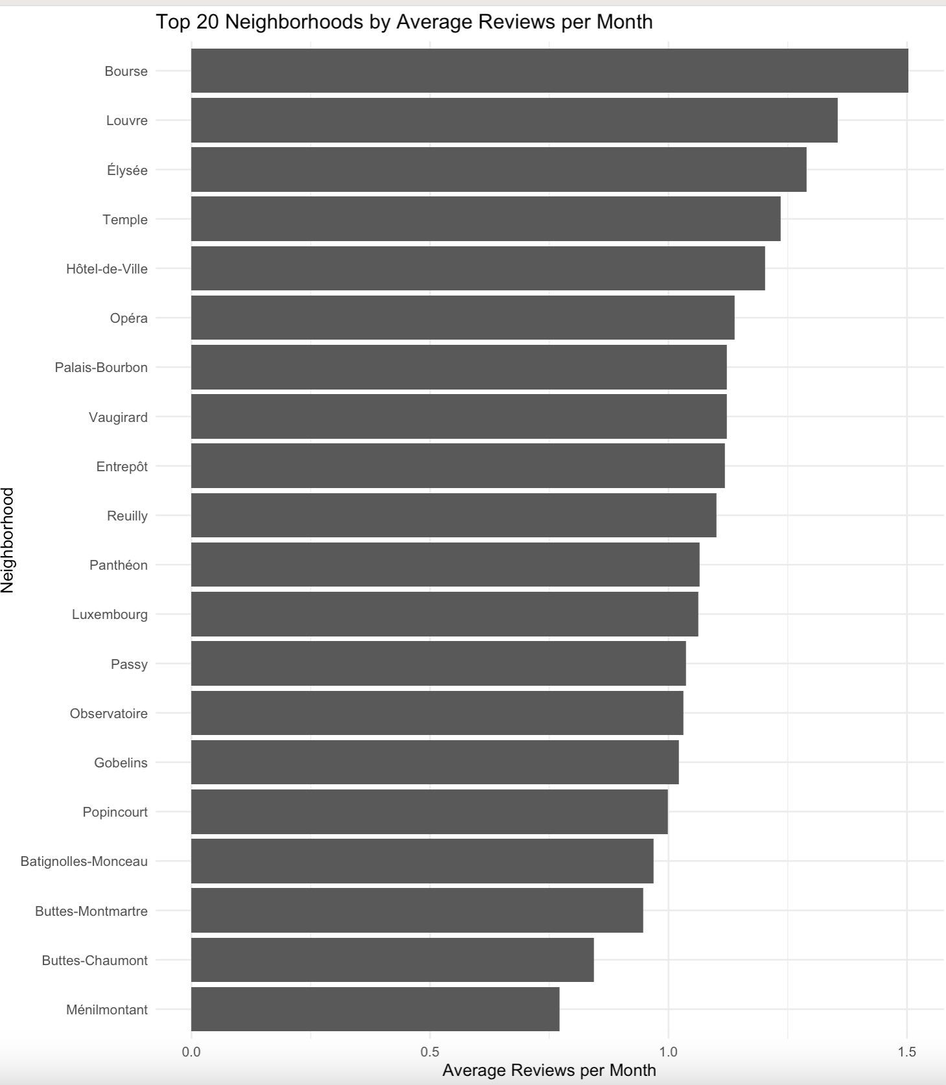
Highest and Lowest activity in the neighborhoods, based on reviews

Slide 8
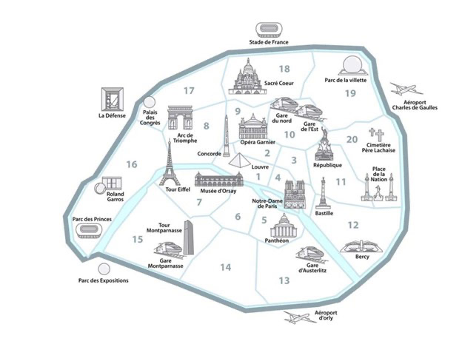
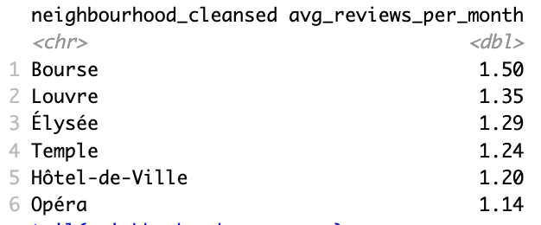
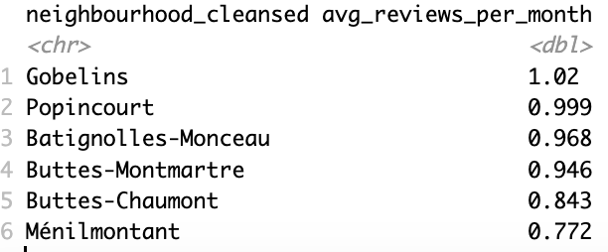
Highest
Lowest
Highest and Lowest activity in the neighborhoods, based on reviews
Visualized
Highest: 2nd, 1st, 8th, 3rd, 4th, 9th | | Lowest: 13th, 11th, 17th, 18th, 19th, 20th

Slide 9
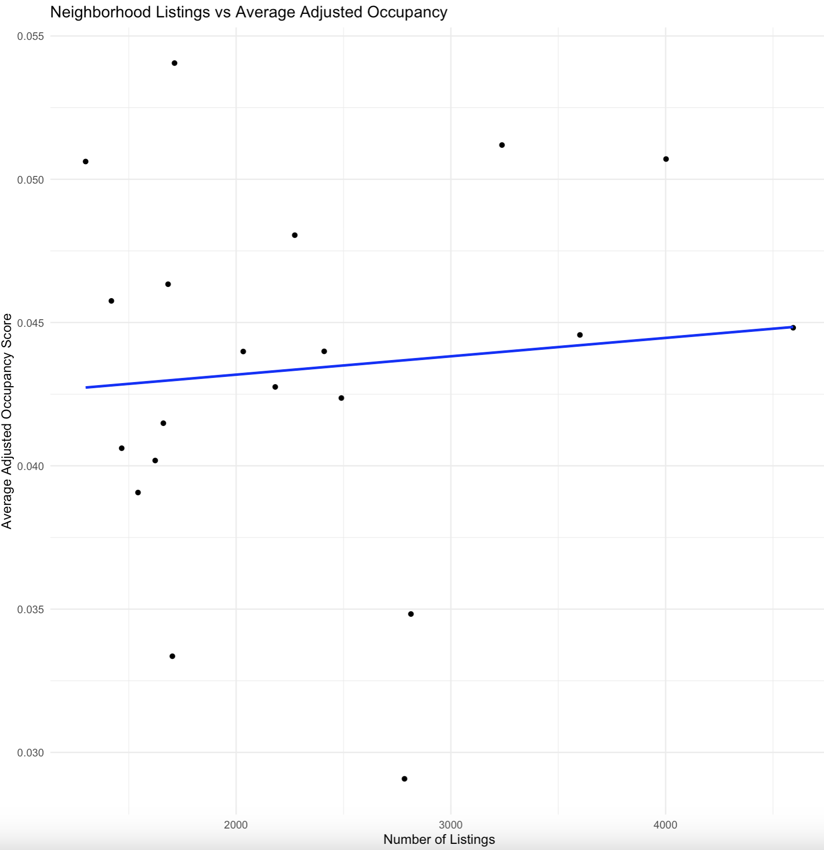
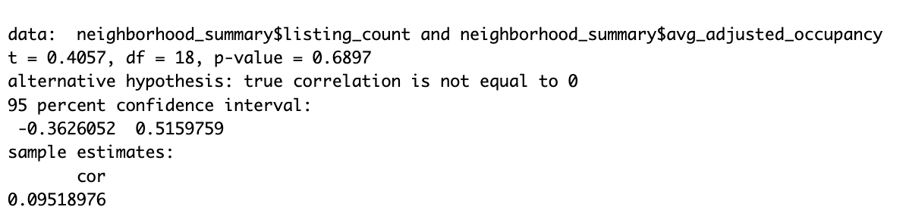
There is a very slight positive trend (more listings = slightly higher occupancy).
But the points are very spread out → no strong clear pattern visually.
No strong evidence that the number of listings affects occupancy.
More listings in a neighborhood does NOT significantly hurt or help occupancy.
Correlation (r) = 0.0952 | Very weak positive relationship
p-value = 0.6897 | Not statistically significant (way > 0.05)
95% confidence interval = -0.36 to 0.52 | Includes 0, meaning no real correlation
Number of Listings Vs Average Adjusted Occupancy

Slide 10
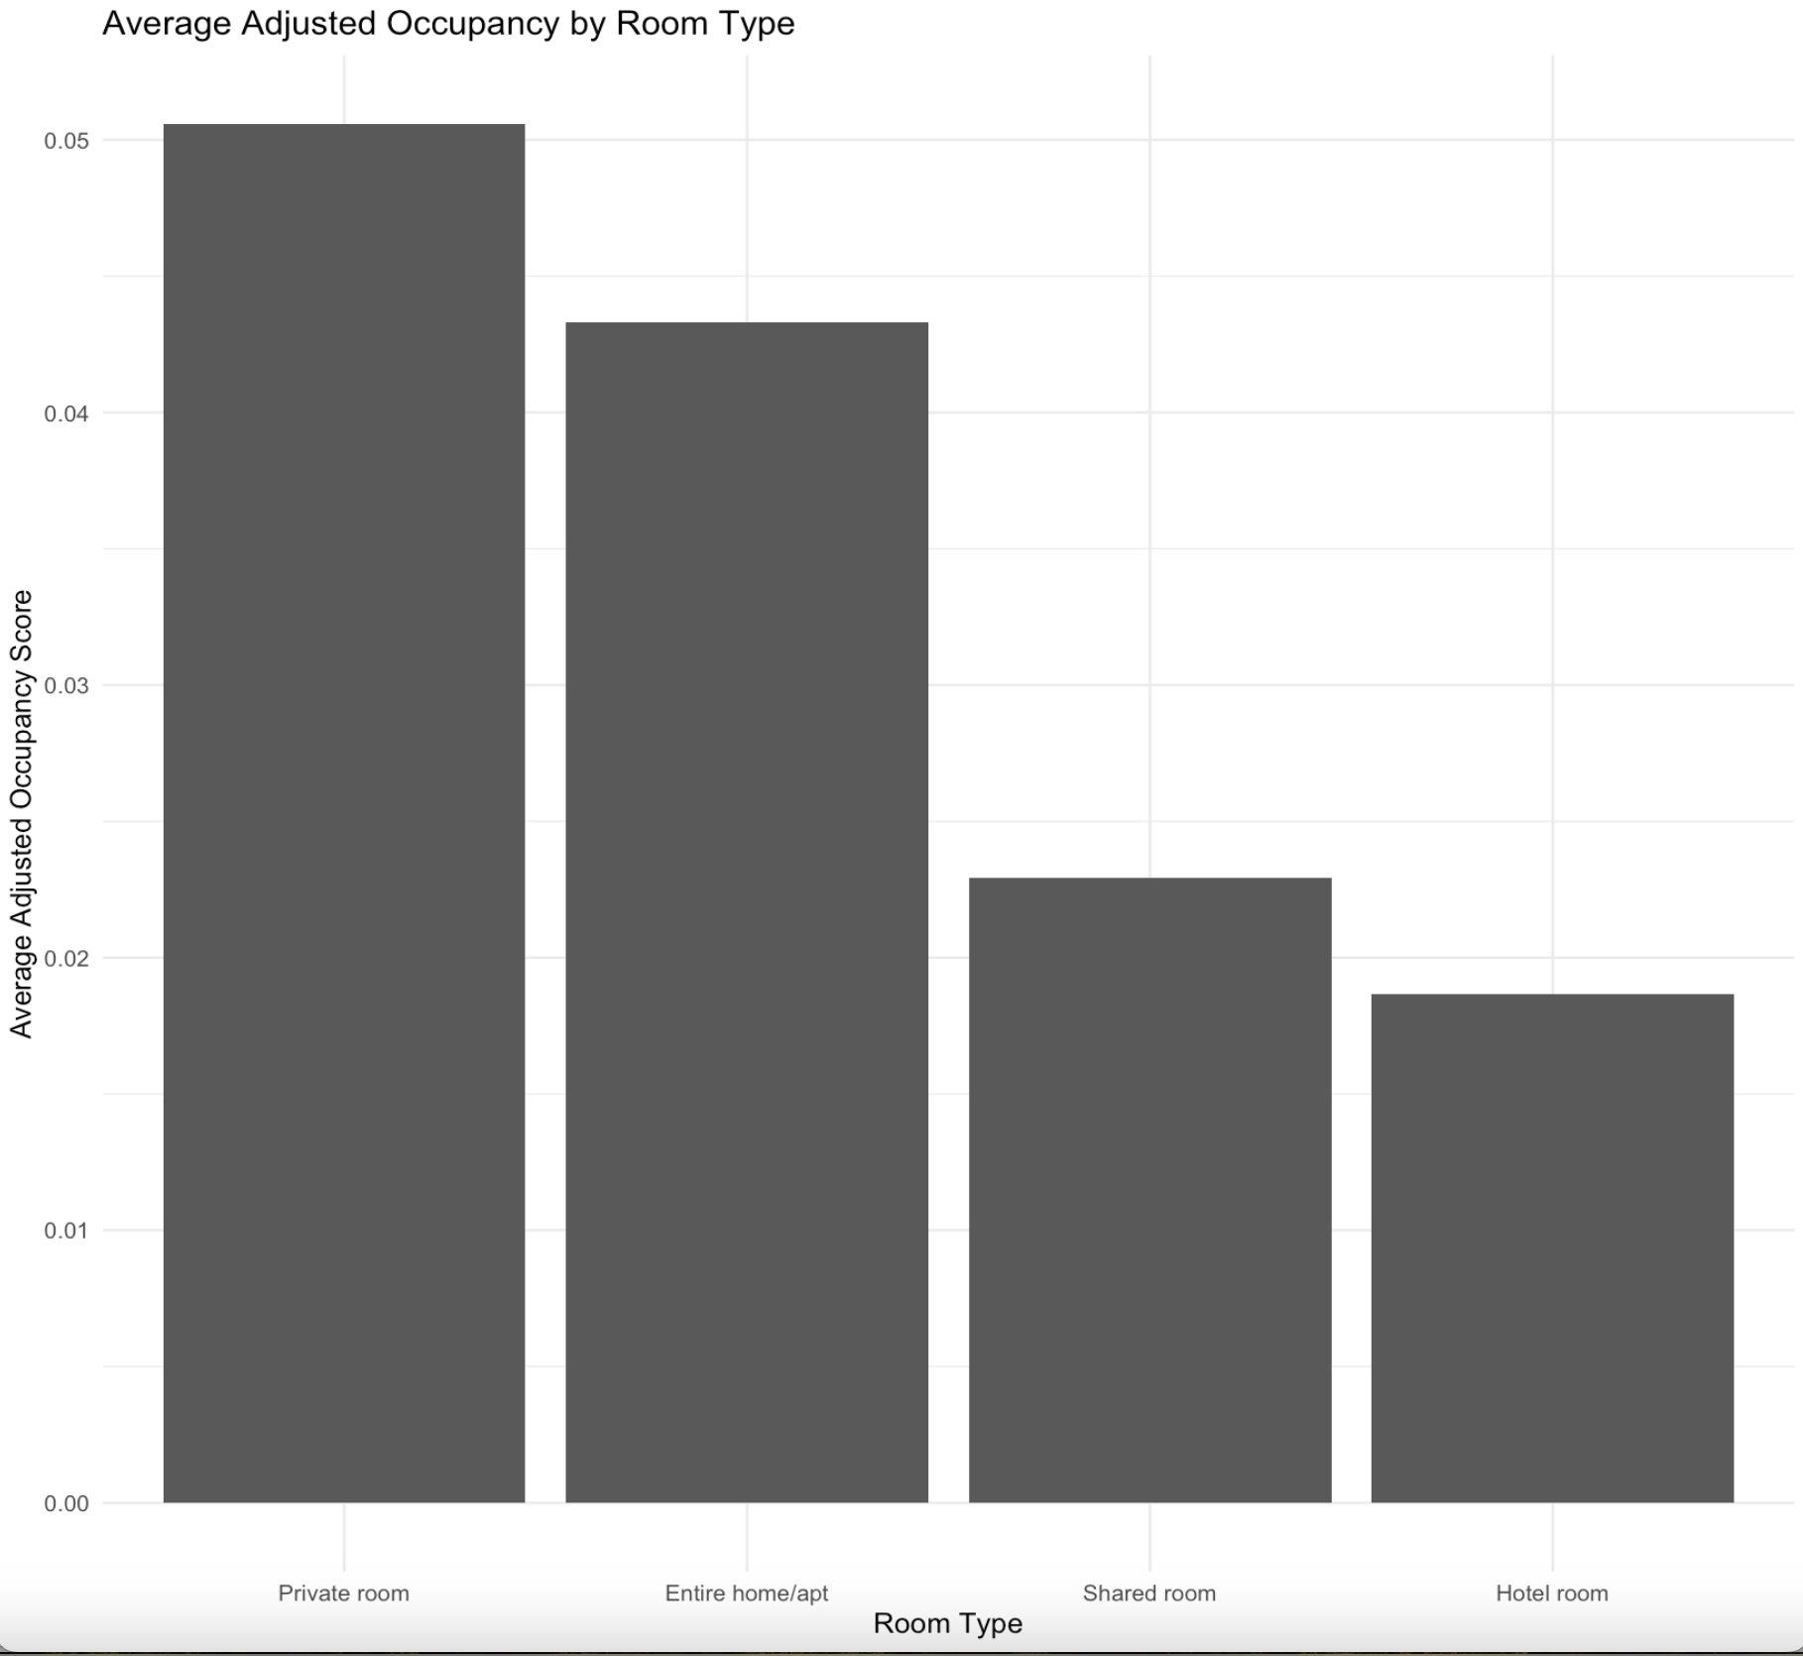
Room Types
Private rooms have the highest average occupancy rate among all Airbnb listings in Paris
Followed by entire homes/apartments.
Shared rooms and hotel rooms perform significantly worse.
This suggests that affordability combined with privacy is highly valued by guests, and listings offering private spaces are more likely to achieve higher occupancy.
This matches broader Airbnb trends, guests often balance privacy and price when choosing.

Slide 11
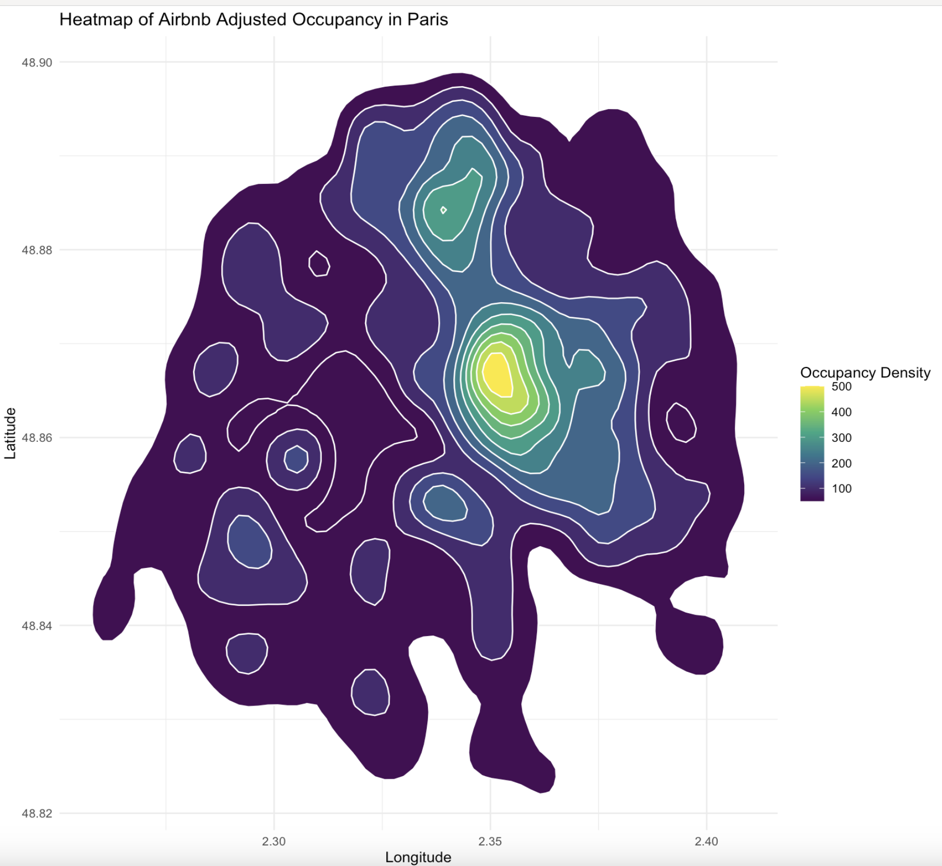
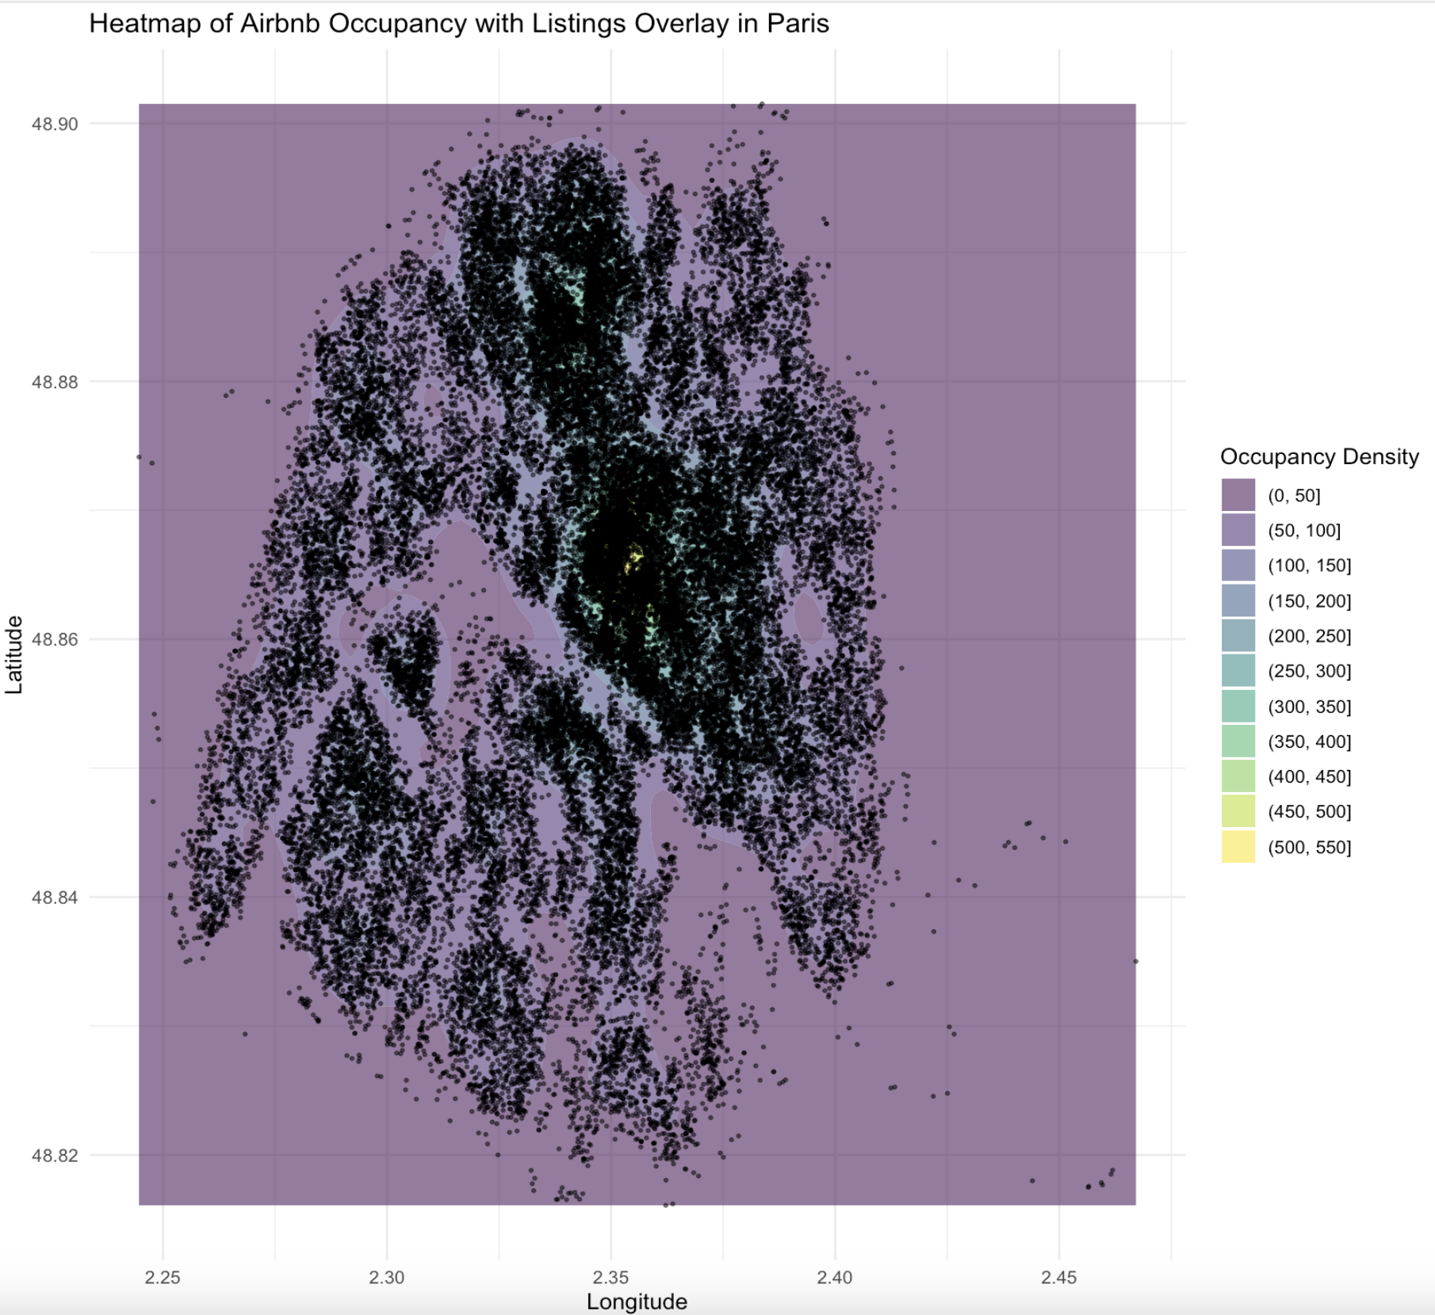
HeatMaps
Eiffel Tower's:Latitude: 48.8584° N and Longitude: 2.2945° E

Slide 12
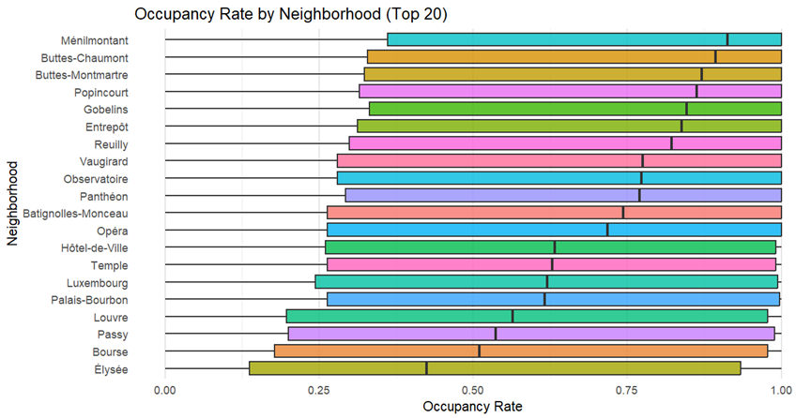
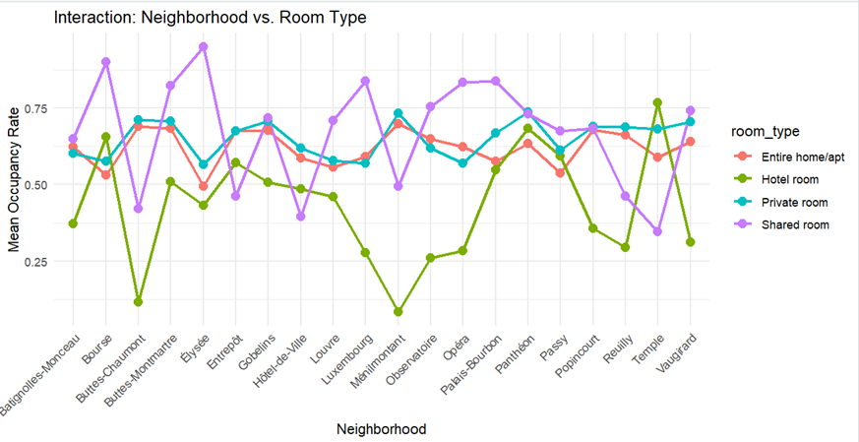
Statistical Analysis
Do Neighborhoods and Room Types Affect Airbnb Occupancy in Paris?
One-Way ANOVA:
Test: occupancy_rate ~ neighbourhood_cleansed
F(19, 91011) = 106.8, p < 2e-16
η² = 0.0218 → Small effect
Two-Way ANOVA (With Interaction):
Test: occupancy_rate ~ neighbourhood_cleansed &
room_type
All terms significant:
Neighborhood (η² = 0.0218)
Room Type (η² = 0.0023)
Interaction (η² = 0.0036)

Slide 13
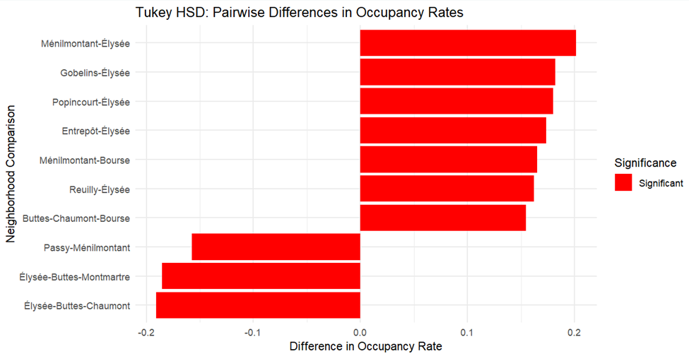
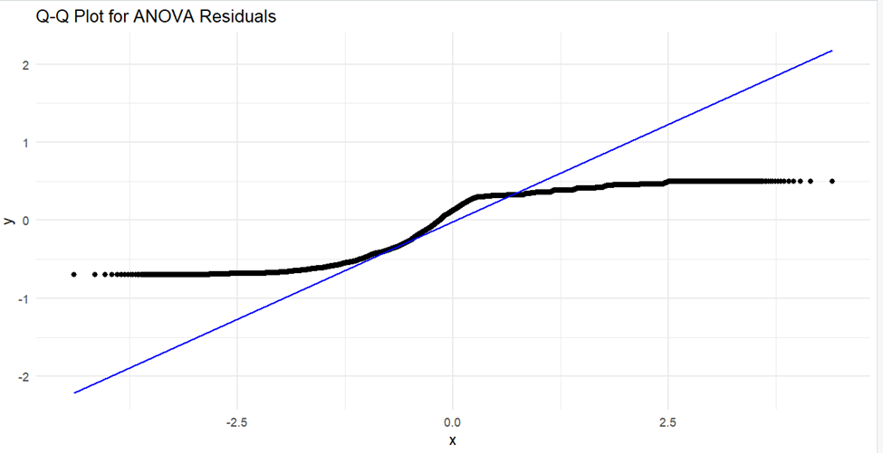
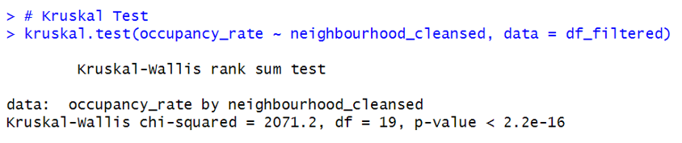
Post-Hoc: Tukey HSD Test:
Élysée significantly outperforms Ménilmontant, Gobelin,
Popincourt.
Helps identify top-performing zones for marketing/pricing.
Kruskal-Wallis Test: Confirms differences across neighborhoods
(p < 2.2e-16) Q-Q Plot: Minor tail deviations – normality is acceptable
Boxplot:
Élysée: High & consistent occupancy
Buttes-Chaumont, Ménilmontant: High variability
Interaction Plot:
Shared rooms = highly location-sensitive
Private & entire homes = stable
Hotel rooms = inconsistent

Slide 14
Correlation & Regression Analysis
Does increasing price lower bookings?

Slide 15
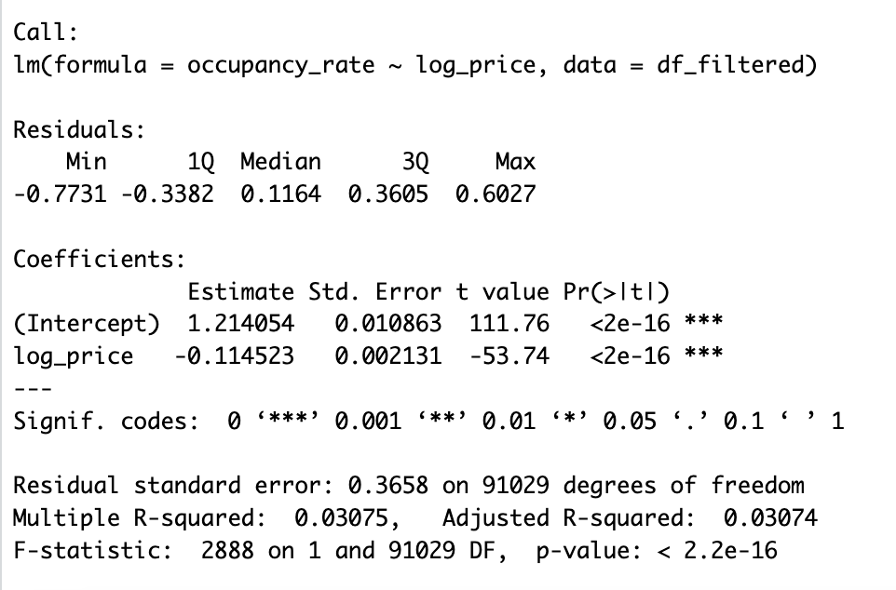
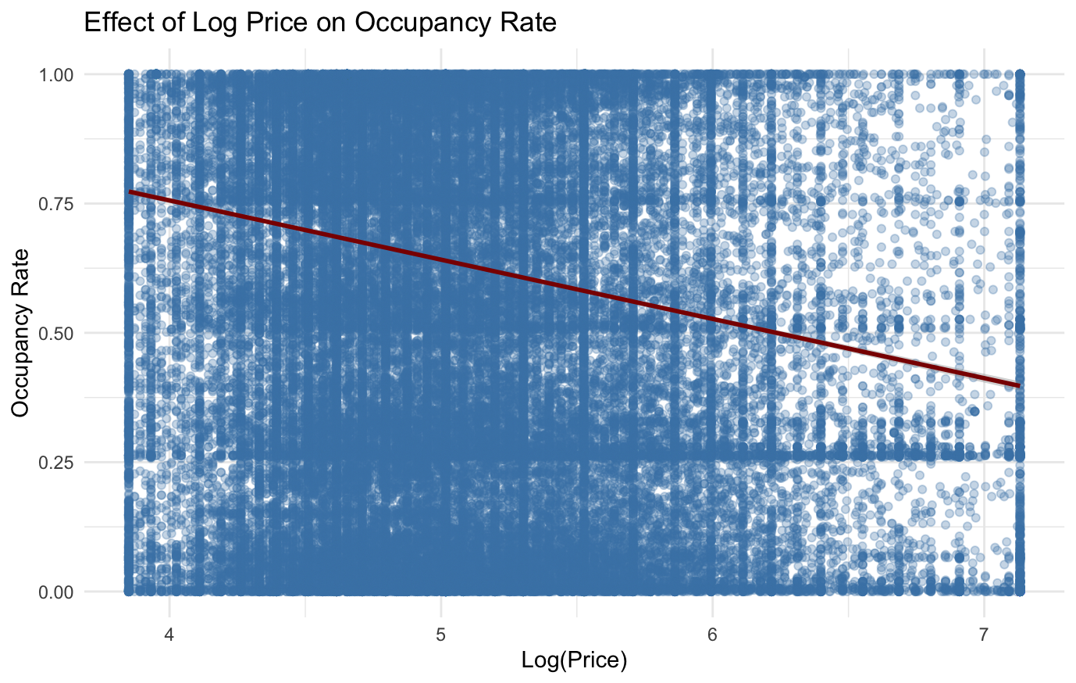
Yes — the analysis shows that as log(price) increases, occupancy rate significantly decreases.
The regression coefficient for log_price is -0.1145, meaning higher prices are associated with lower booking rates.
This negative effect is highly statistically significant (p-value < 2e-16).
The scatter plot with the trend line visually confirms this downward trend in occupancy as prices rise.

Slide 16
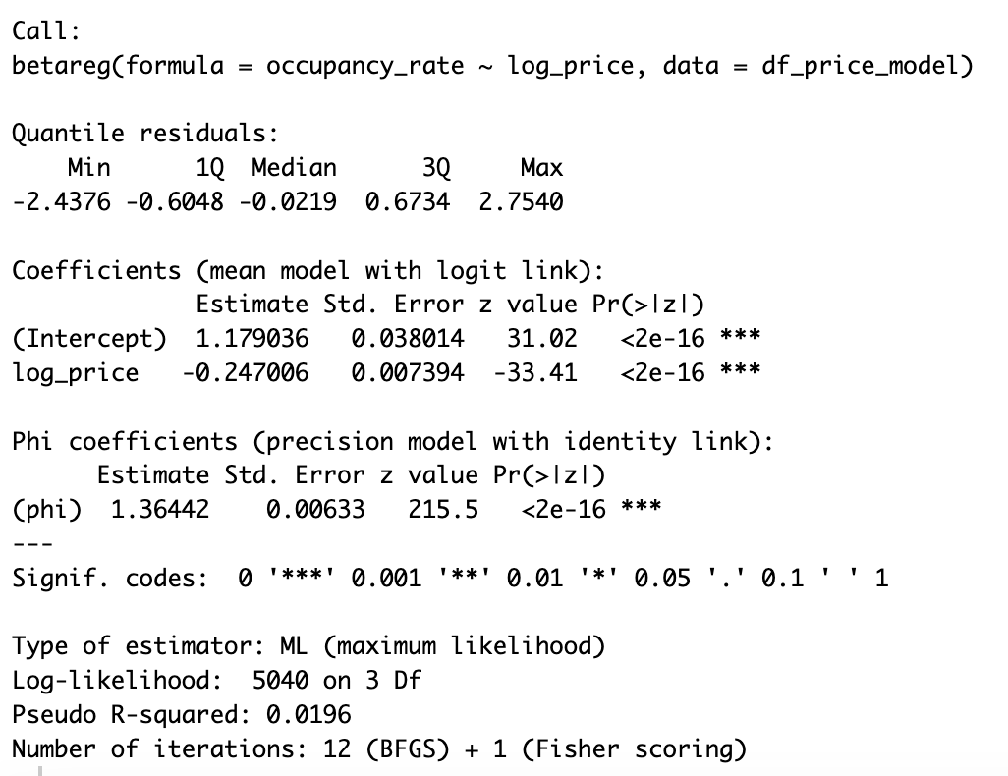
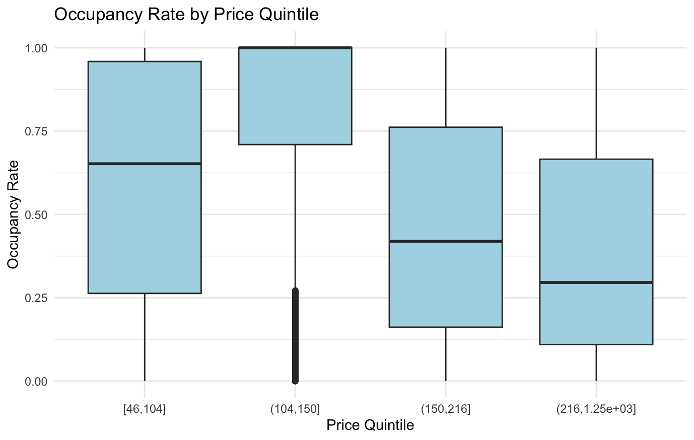
Yes — Beta regression confirms a strong negative relationship between log(price) and occupancy rate.
The coefficient for log_price is -0.247, statistically significant (p < 2e-16).
The boxplot shows lower occupancy rates in higher price quintiles, especially above $216.
As prices rise, bookings drop — but the effect size varies across price levels.

Slide 17
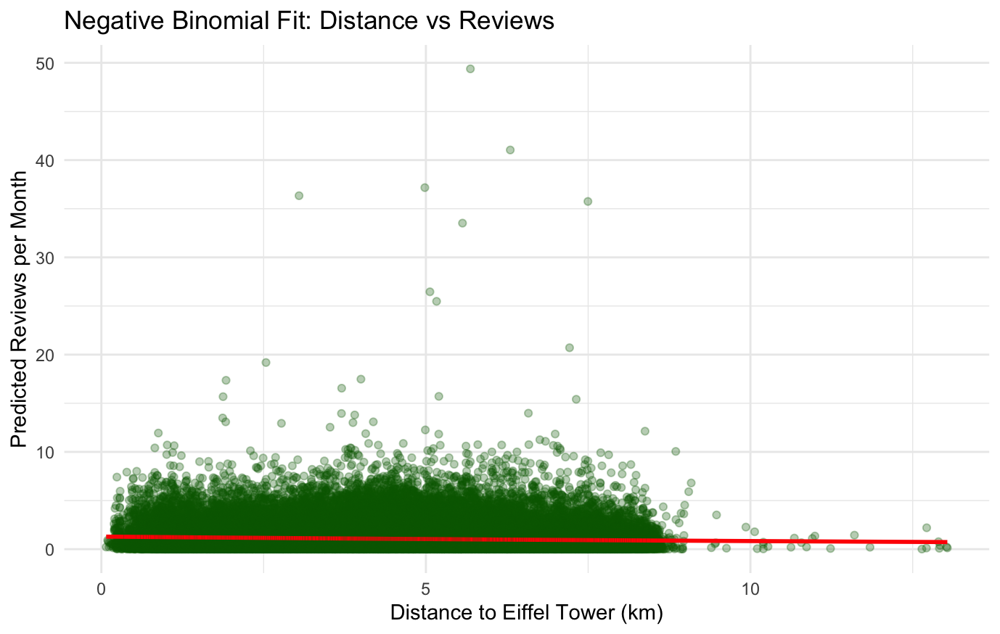
Correlation & Regression Analysis
Does closer distance lead to more bookings?
Yes — Listings closer to the Eiffel Tower receive more bookings.
The negative binomial model shows a significant negative effect of distance (coef = -0.0439, p < 2e-16).
The red line in the plot shows predicted bookings decrease as distance increases.
Distance matters, but it explains only a small portion of variation in bookings (pseudo R² ≈ 0.005).

Slide 18
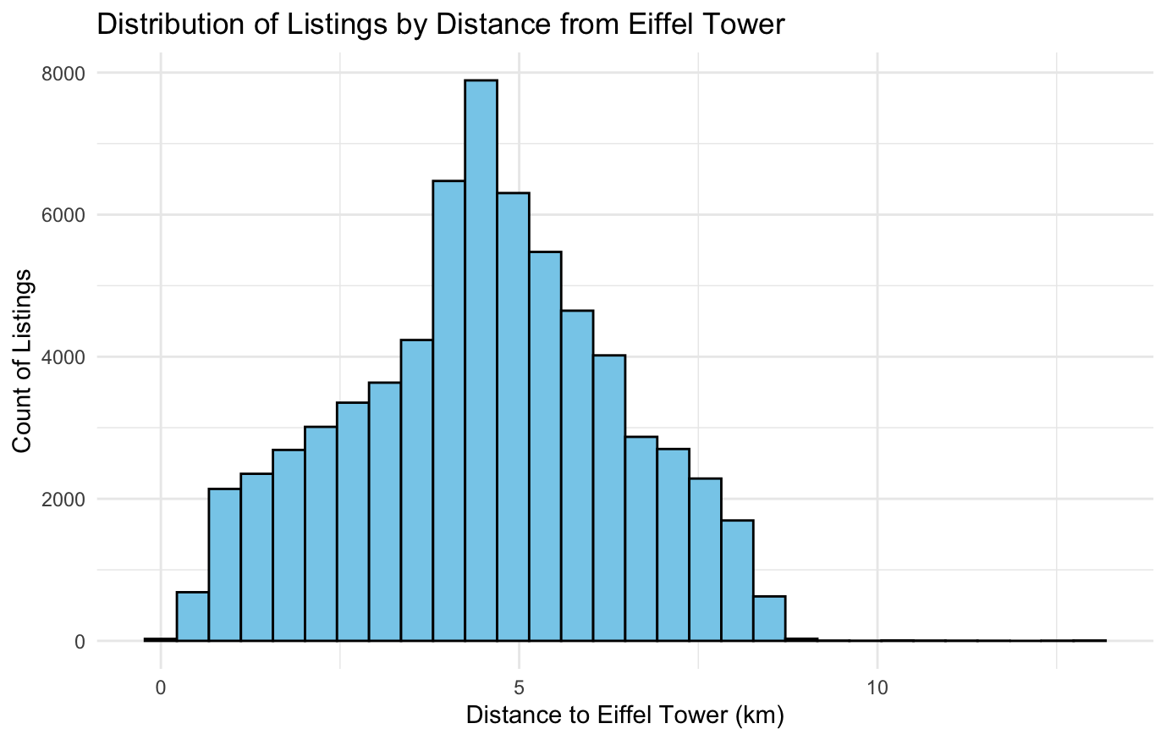
Distribution of Listings by Distance
Most Airbnb listings are located between 3 to 6 km from the Eiffel Tower.
This provides a reliable sample for evaluating how distance impacts bookings.
Ensures that our model’s negative relationship between distance and reviews per month is not skewed by sparse data at extreme distances.

Slide 19
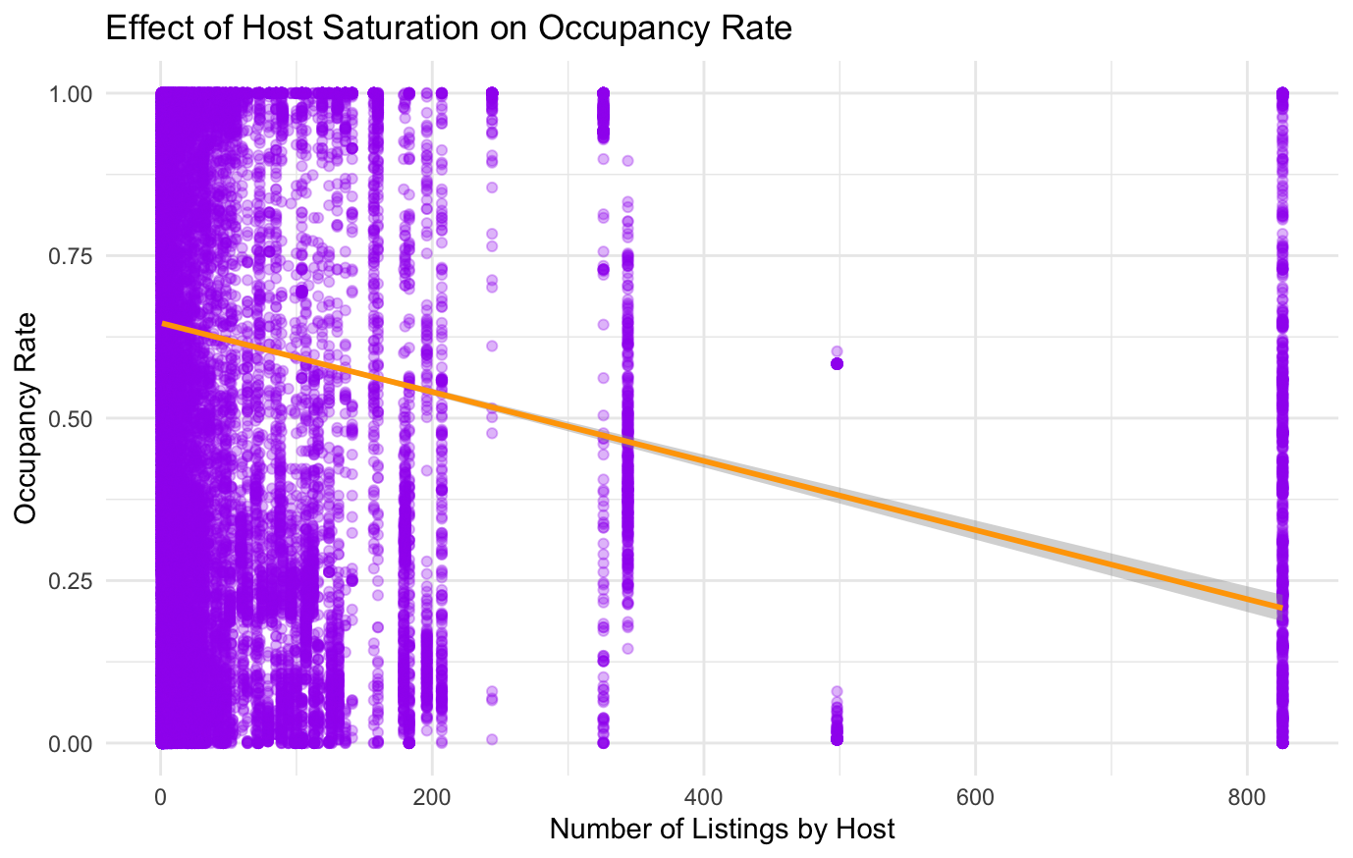
Correlation & Regression Analysis
Does too much competition reduce occupancy?
Yes — Hosts with more listings tend to have lower occupancy rates.
Both linear and beta regression show a significant negative relationship between host listing count and occupancy.
Linear coef: -0.00053, Beta coef: -0.00109 (both p < 2e-16)
The scatterplot (right) shows occupancy declines as host listing count increases.
Suggests over-saturation or diluted attention may reduce booking performance.

Slide 20
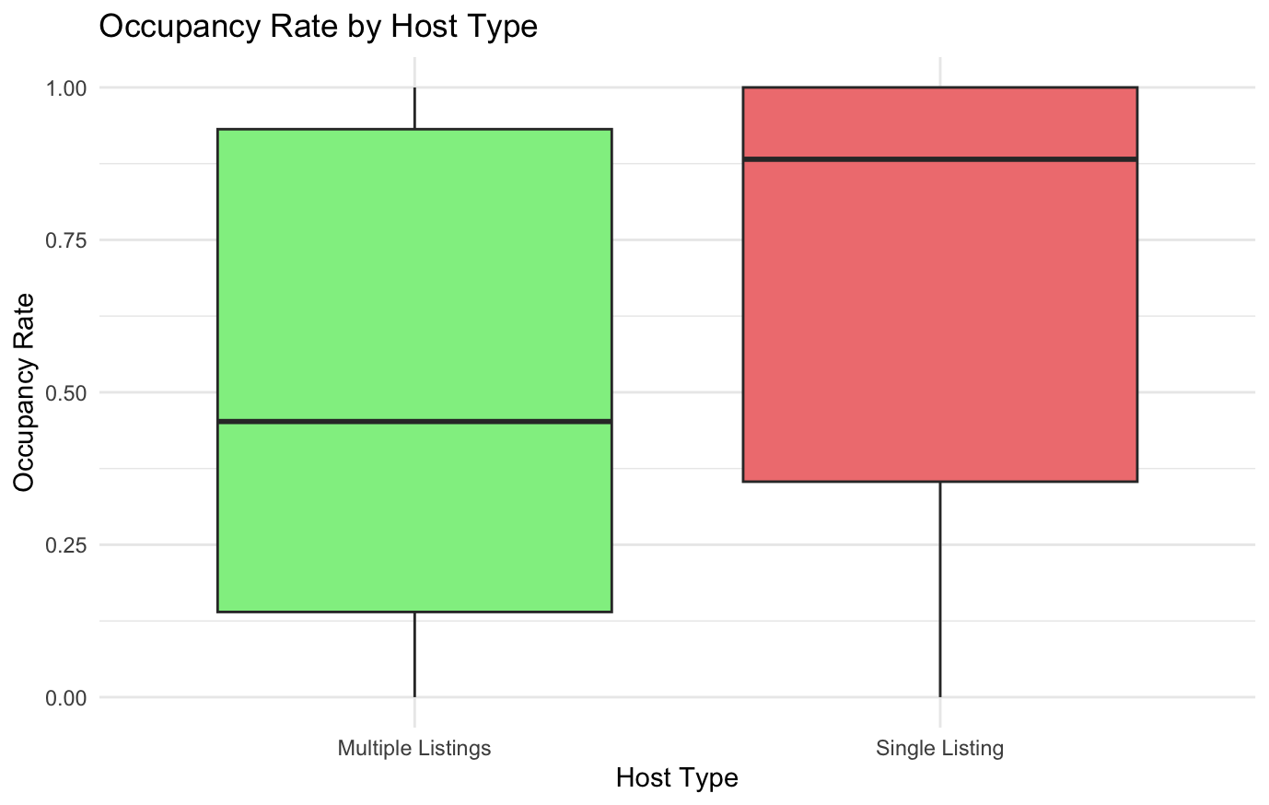
Insight:
Single-listing hosts have a higher median occupancy rate than those with multiple listings.
Multi-listing hosts show more variability and generally lower occupancy.
This supports the idea that increased competition from the same host can reduce performance per listing, possibly due to less personalized attention or market dilution.

Slide 21
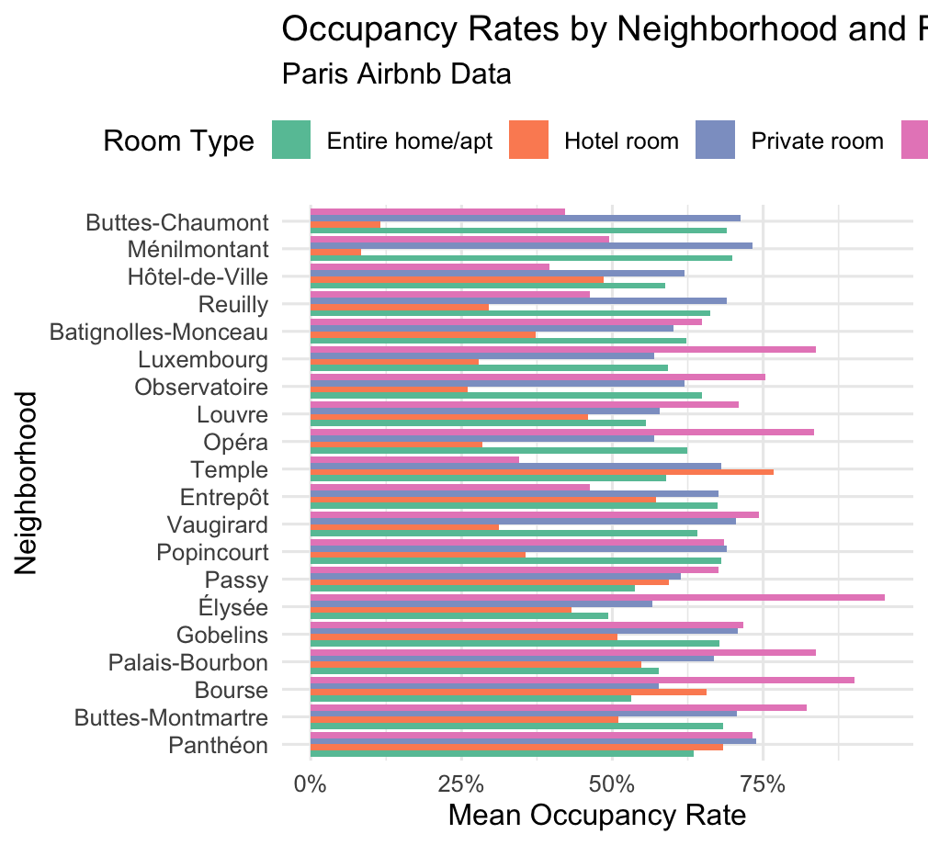
Mean Occupancy Rate
Entire Home : Highest occupancy (~75%) in tourist zones like Louvre & Opéra which is ideal for premium pricing.
Private Rooms : Steady demand (~50%) in residential areas (Ménilmontant) which could be optimized for long-term stays.
Shared Rooms : Niche high-occupancy (~80% in Bourse). These usually target budget travelers and interns.
Hotel rooms : Lowest occupancy (~25%). Tourists avoid in luxury areas (Élysée).

Slide 22
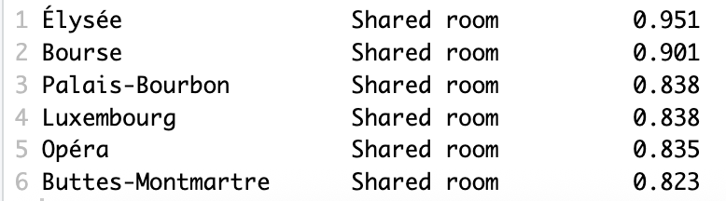
Mean Occupancy Rate
Top 5 investment opportunities for hosts
Shared Rooms have had an advantage over the other types of rooms in these places.
Elysee, Opera, Palais-Bourbon and luxembourg have been occupied the most because of its close proximity to tourist attractions.
Bourse’s high occupancy rate is likely due to the financial district attracting work/trips.
Even though there is high demand in Elysee, there is low supply of rooms in Elysee.

Slide 23
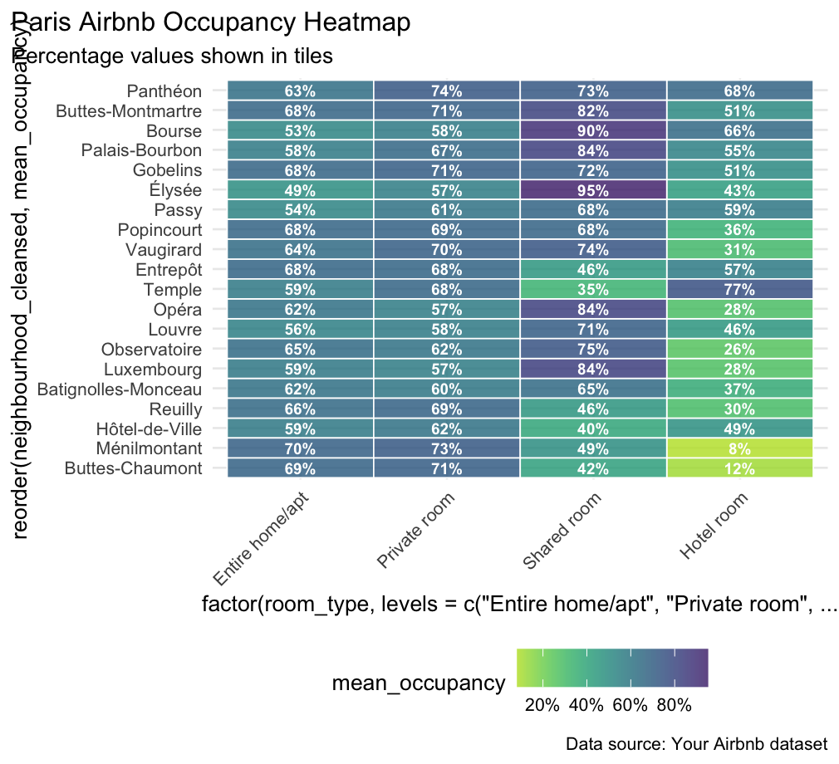
Heat Map of Occupation
Elysee (95%), Bourse (90%), and Opera (84%) show unusually high shared-room demand—likely from business travelers and luxury seekers.
Menilmontant (8%) and Buttes-Chaumont (12%) have disastrous hotel occupancy
Buttes-Montmartre (84%) and Louvre (75%) perform best for entire homes, but shared rooms compete closely (82% vs. 84%).
Bourse’s 90% occupancy suggests untapped demand for budget-friendly work stays (interns, contractors).

Slide 24
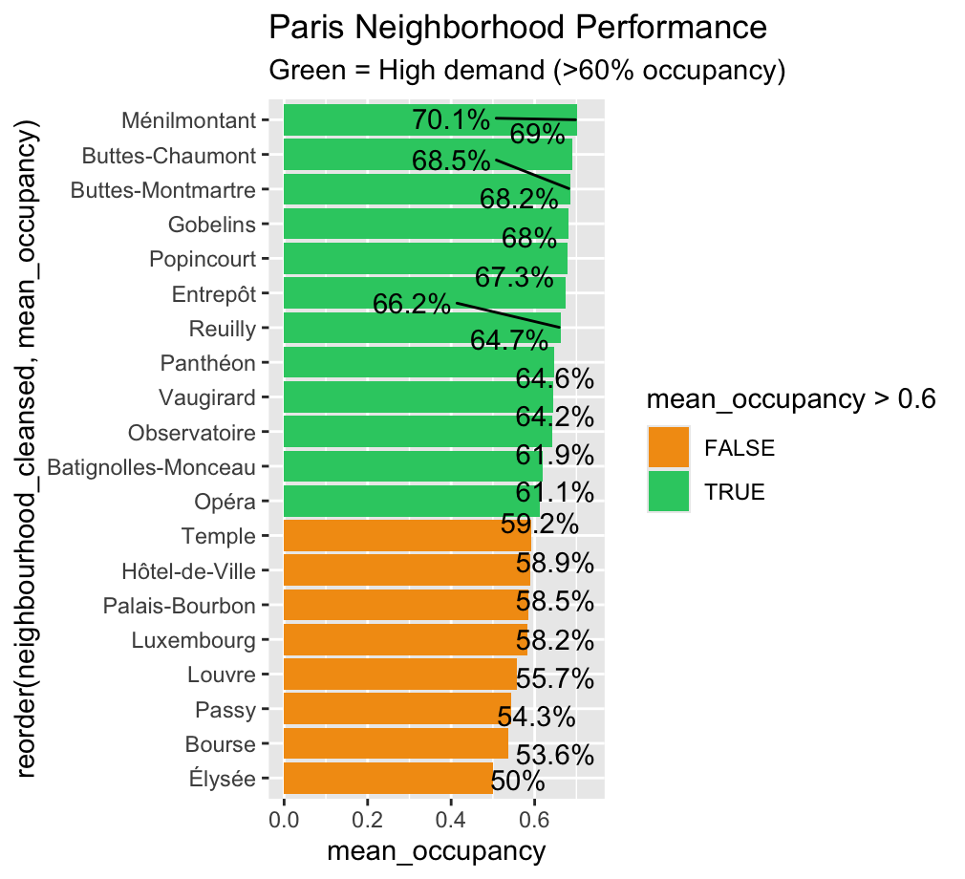
Occupancy Rate Ranking
Top Performers:
The top 5 performers have charms like nightlife experience, tourist hotspots with high demand for entire homes and suburban charm that attracts long-term stays.
Some of these are within University proximity which increases demand for private rooms.
Mid Tier Performers:
Places like Louvre, Palais-bourbon charge more as they are in close proximity to tourist attractions.
Passy, Bourse have people who are on business trips/work as it is close by financial district
Underperformer
Elysee being the only underperformer here as it has prices which often leads to low occupancy.

Slide 25
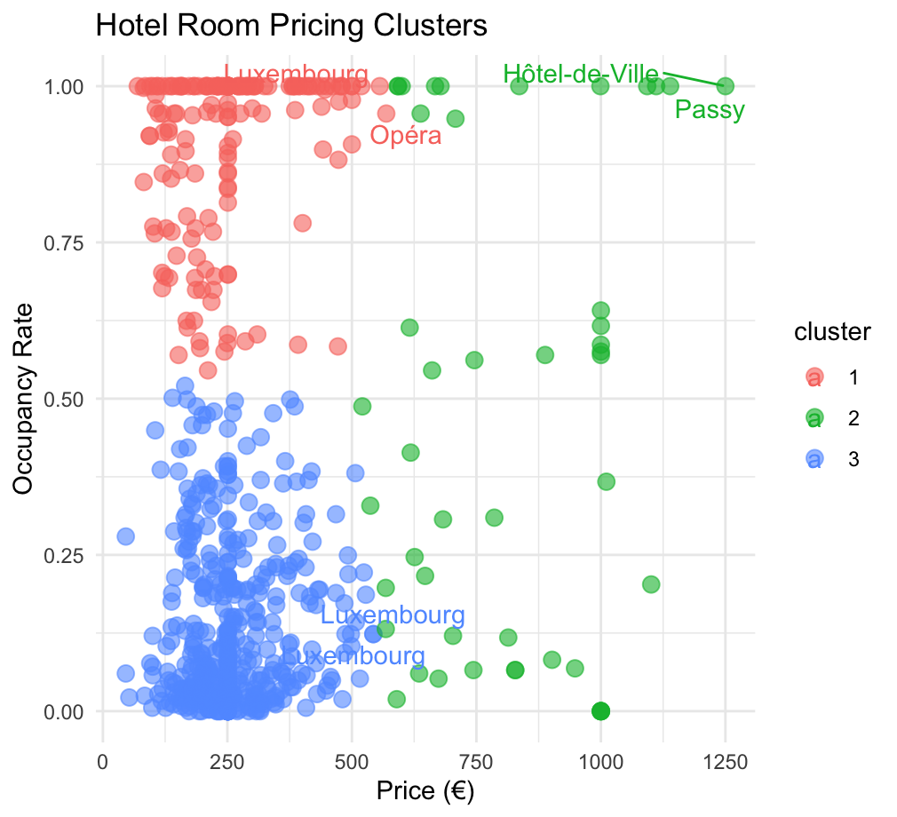
Hotel Room Pricing
Pricing
Cluster 1(red): This cluster has a low price and high occupancy.
Cluster 2(blue): This cluster has a moderate price and moderate level of occupancy.
Cluster 3(green): This cluster has low occupancies and high price.
Strategies
For cluster 1, Increase prices 15-20% (high demand, underpriced).
For cluster 2, they could optimize their pricing structure.
For cluster 3, they could either decrease prices or convert to private rooms.

Slide 26
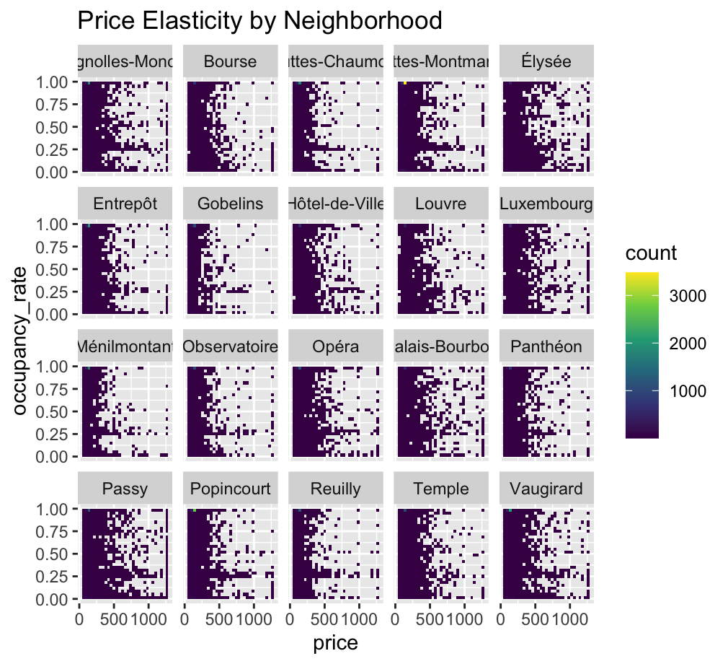
Price Elasticity
Price elasticity of demand measures how sensitive demand like occupancy rate is to price changes.
Vertical patterns : Elysee show dark vertical streaks which indicates that occupancy stays high even as prices increase.
Horizontal patterns : Passy shows dark horizontal streaks which tells us that occupancy drops sharply when prices exceed.
Balanced patterns : Luxembourg has occupancy declining gradually with increase in pricing.

Slide 27
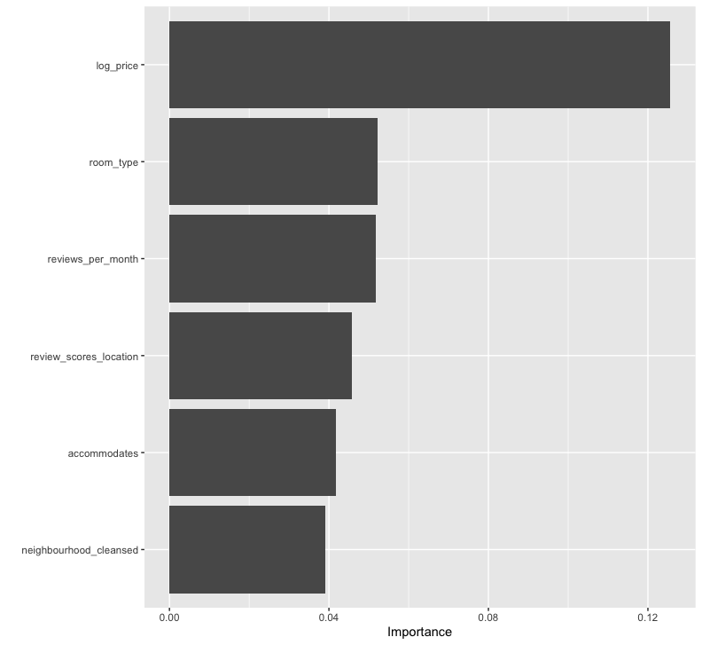
Variable Importance Plot
The relative influence of each variable on our model's predictions, Higher bars equals to greater impact.
Log_price has the highest importance as small prices changes disproportionately which affect bookings.
Reviews_per_month creates an impact within consumers, if there are frequent reviews these boost visibility which help in bringing more eyes.
Review_scores_location also has an impact as guests prioritize location quality over amenities.

Slide 28
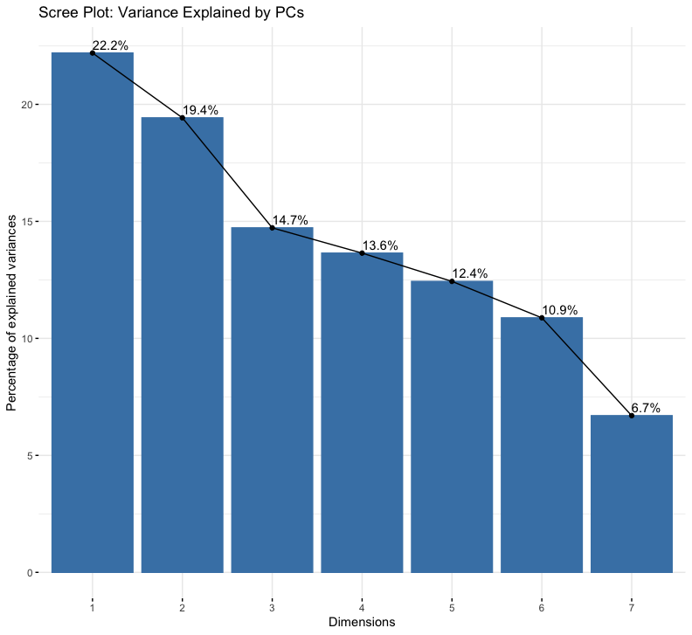
Principal Component Analysis
Principal component analysis (PCA) is a linear dimensionality reduction technique with applications in exploratory data analysis, visualization and data preprocessing.
PC1(22.2%) : Captures the high performing listings like high review, strong reviews, elevated number of reviews. These indicate which ones are frequently booked , well rated-properties etc.
PC2(19.4%) : Captures affordable, always-available listing and also pricier and selectively available properties.
PC3+ : These capture Niche patterns like less nights, room types.

Slide 29
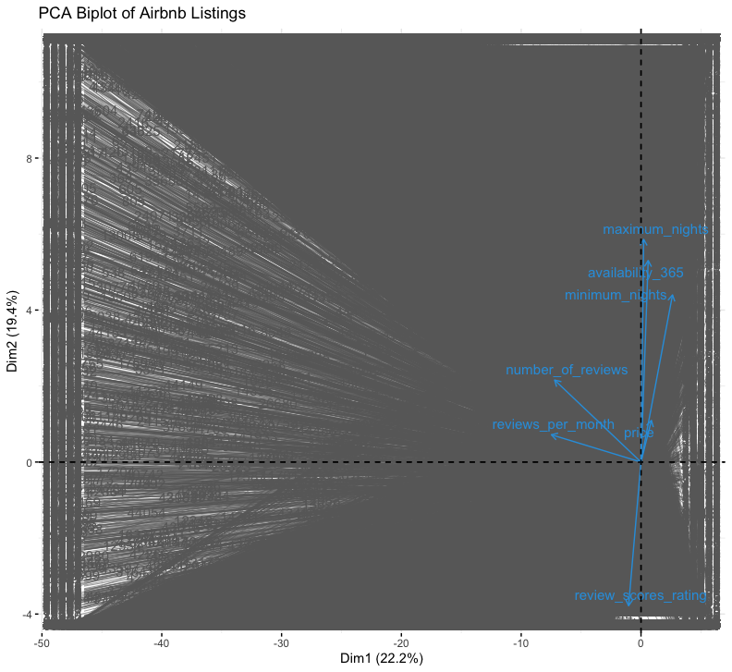
PCA Biplot
Biplot combines variable vectors and listing positions to show how the variables correlate and how listing cluster.
reviews_per_month + number_of_reviews point strongly right → Drive PC1 (22.2%).
availability_365 points downward → Year-round availability correlates with lower ratings
price points left (negative PC1) → Higher prices reduce occupancy.
Vertical spread → Influence PC2 (19.4%) more than PC1.
Clusters
Top-Right: High-review, high-occupancy listings (align with review vectors).
Bottom-Left: Pricey, always-available listings (often with lower ratings).
Middle: Balanced properties (moderate prices, seasonal availability).
Strategies
To boost popularity one would have to increase reviews and ratings to move towards the right side.
To balance price and availability one would have to avoid the bottom left side.

Slide 30
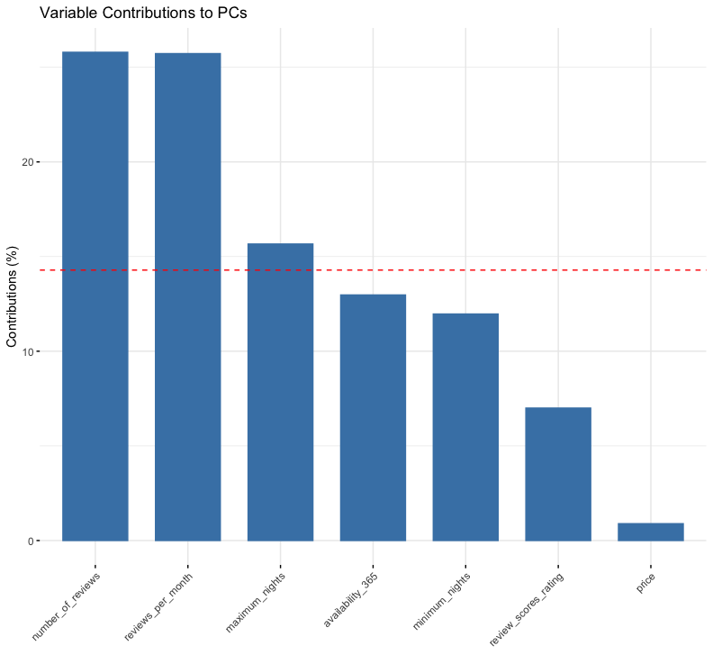
Variable Contributions to PC
From these graphs, we can see that :
Review_per_month are the number 1 driver of listing popularity.
Number_of_review means more trust for the customers.
Year- round availability might hurt ratings
Higher prices reduces the occupancy of customers.
Review_scores_ratings contribute less than expected as guests prioritize quantity of reviews over average rating.
Strategies
Focus on improving review_per_month and also the pricing structure.
“Always available” listings often underperform.

Slide 31
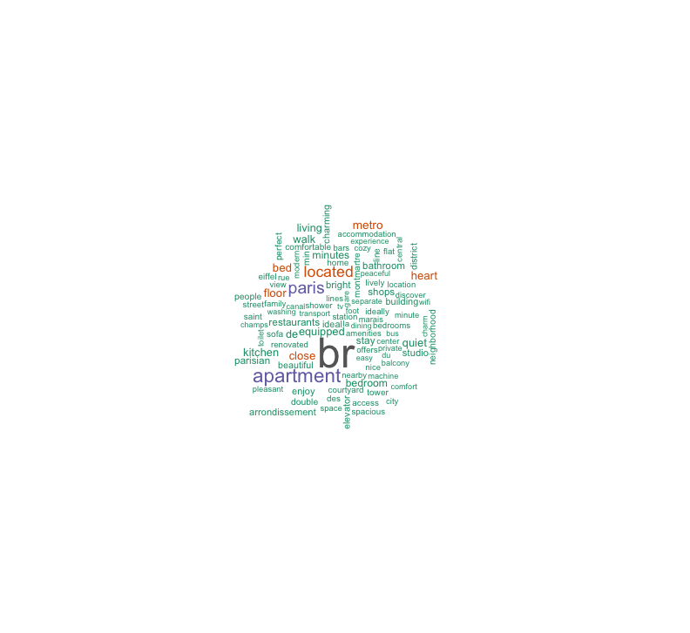
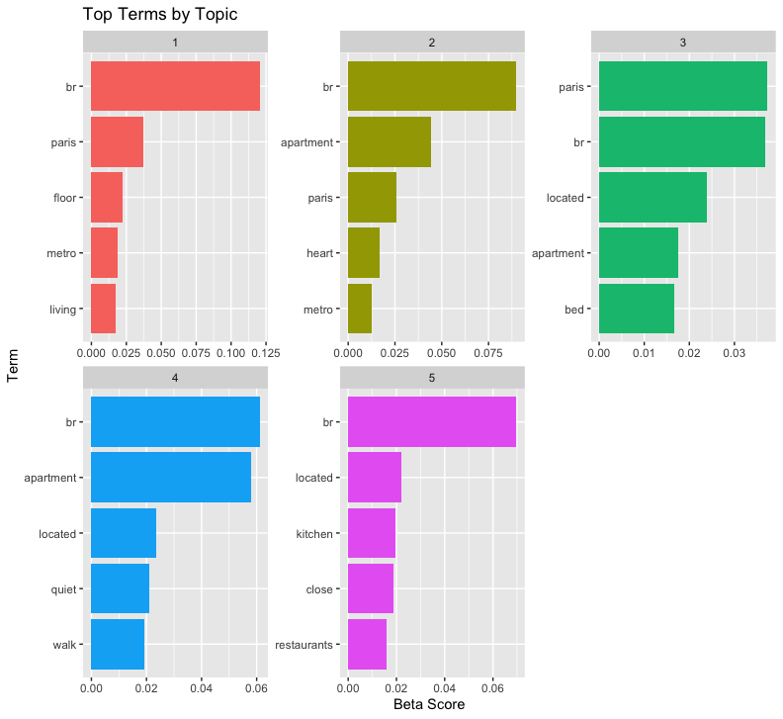
Terms by Topic
"br" (bedroom) is the most frequently mentioned term across all topics, indicating its high importance in guest reviews.
Terms like “paris”, “metro”, and “located” highlight the strong focus on location and accessibility.
Guests often mention amenities such as “kitchen”, “closet”, and “restaurants”, suggesting the value placed on convenience.
Words like “quiet” and “walk” reflect guest preferences for peaceful surroundings and walkable neighborhoods.

Slide 32
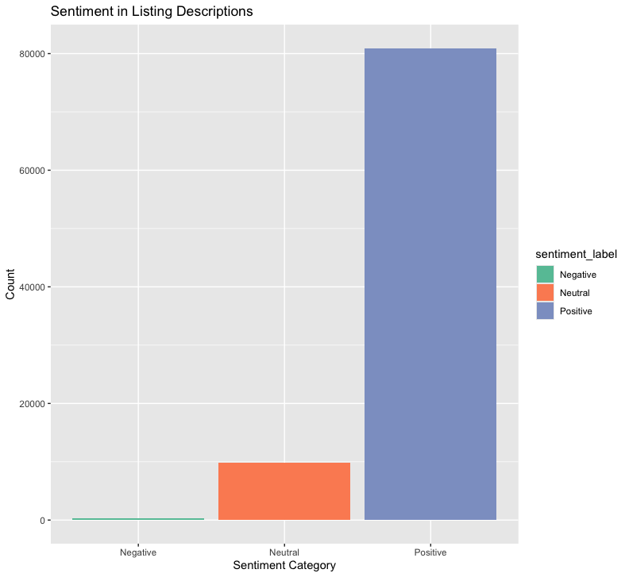
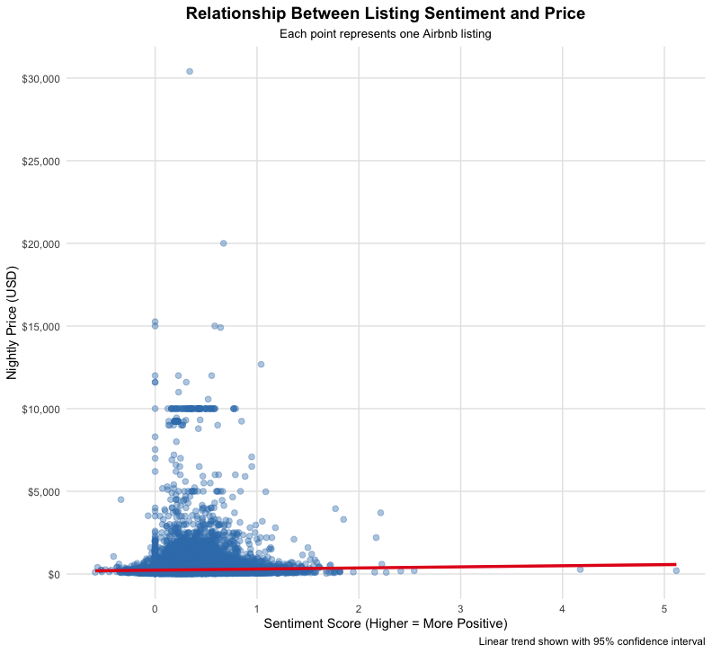
Sentimental Analysis
Positive Correlation: The graph shows a positive relationship between the sentiment score of listings and their prices. As sentiment increases, prices tend to rise.
Confidence Interval: The overall trend is upward, there is some variability in the data. The wider the interval, the less certain the exact relationship may be in certain regions.
Data Spread: The trend line, showing that while sentiment generally correlates with price, other factors likely influence pricing as well.

Slide 33
Key Takeaways from the Project
This project demonstrates full application of BIA 672 concepts through a data-driven analysis of Airbnb listings in Paris. We applied cross-sectional analysis to explore occupancy patterns, used regression models to predict booking behavior, and implemented PCA and clustering for market segmentation. We also performed text mining, topic modeling, and sentiment analysis to extract insights from listing descriptions. Collectively, these techniques enabled us to assess pricing elasticity, identify neighborhood-level saturation, and understand guest sentiment covering all major topics from basic data analysis to advanced predictive modeling and big data decision tools.

Slide 34
Part - III

Slide 35
Recommended Decisions
Optimize Room Type Strategy:
Focus on promoting private and shared rooms, which have shown the highest occupancy rates (~80% in Bourse and ~50% in residential areas). Convert underperforming hotel rooms (25% occupancy) into private/shared spaces to maximize returns.
Target High-Demand Areas with Low Supply:
Neighborhoods like Élysée and Opera have high demand but limited listings. Encourage new hosts or expansion in these zones to capture unmet demand and drive revenue growth.
Capitalize on Proximity to Attractions:
Promote listings within 3 km of major attractions like the Eiffel Tower, as they consistently receive more bookings and offer higher earning potential.

Slide 36
THANK YOU

